Slide 1
Traceroute Lab

Slide 2
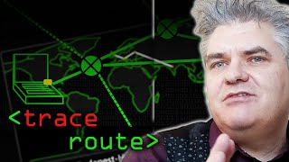
Traceroute Lab

Slide 3
Traceroute Lab
Materials needed
Computer system connected to internet
Software Tools used
traceroute command (Linux and Mac OS)
tracert command (Windows OS)
tracepath command (Chromebooks)

Slide 4
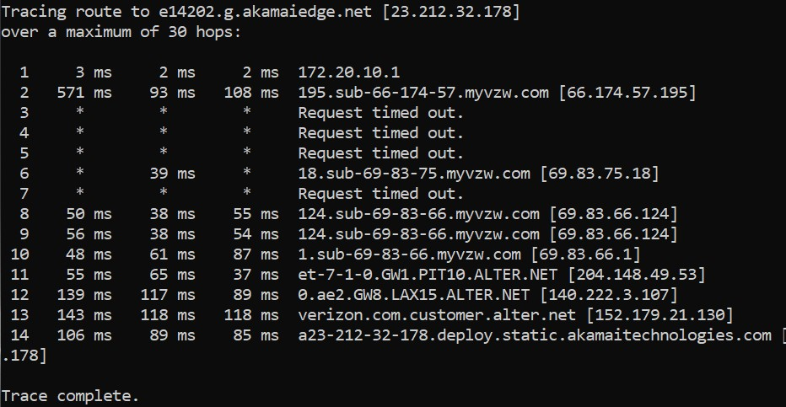
Traceroute Lab
What is traceroute?
The traceroute command shows the path packets take across a network
Shows IP addresses of all the hops
Shows the time between the hops
Example of a trace route
Notes:
Bank: Chase
Username: jsmith17 Password: @pp13s33d

Slide 5
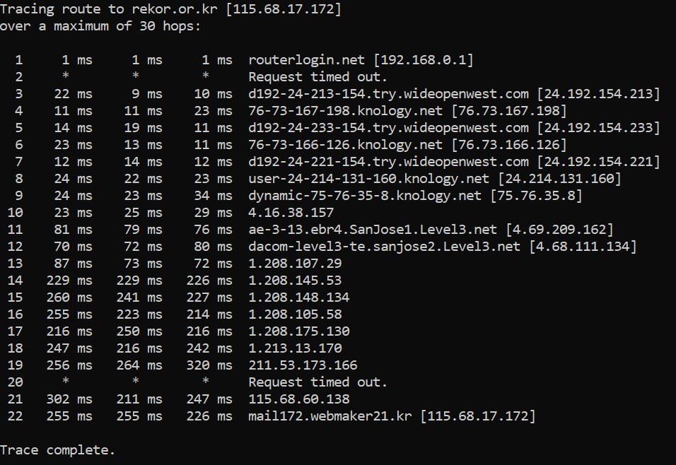
The Trace Route Lab
Open Terminal
Run a Trace Route
Analyze a Trace Route
Analyze a Secure Website
Your Turn

Slide 6
Traceroute Lab
Open the Terminal
Once logged into a system, open the Terminal
Open the Terminal in a Linux system
Can press CTRL+ALT+T in most Linux systems
Open the Command Prompt in a Windows system
Search for “cmd” to find the Command Prompt
Open Terminal in a Mac system
Search for “Terminal” using Spotlight
Open the Command Prompt on a Chromebook
CTRL+ALT+T should open the Command Prompt

Slide 7
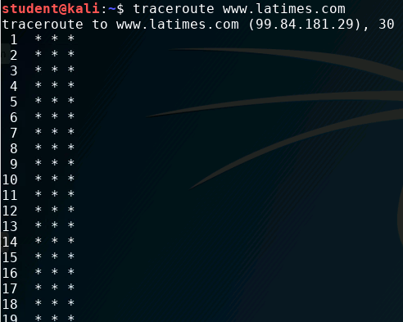
Traceroute Lab
Note: May not work on some ranges
Some cyber ranges disable IMCP Traffic
Some schools might have this traffic shut down on their networks
Here is traceroute run on the US Cyber Range. Notice it does not show any data about the route. All ICMP packets are blocked.

Slide 8
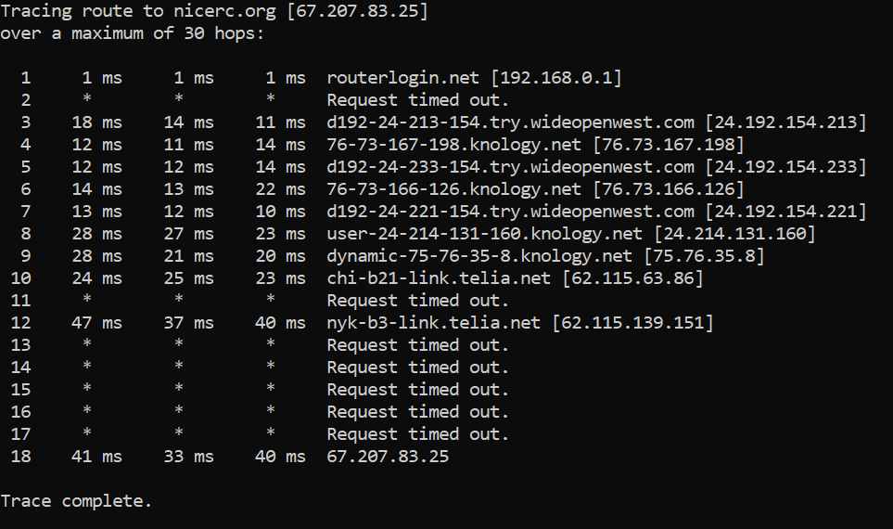
Traceroute Lab
Run a trace route to www.cyber.org
Windows Command:
tracert www.cyber.org
Linux/Mac Command:
traceroute www.cyber.org
Chromebook Command:
tracepath www.cyber.org
What data are you able to find? Notice anything cool/unique?
Notice that this trace route went through both Chicago and New York

Slide 9
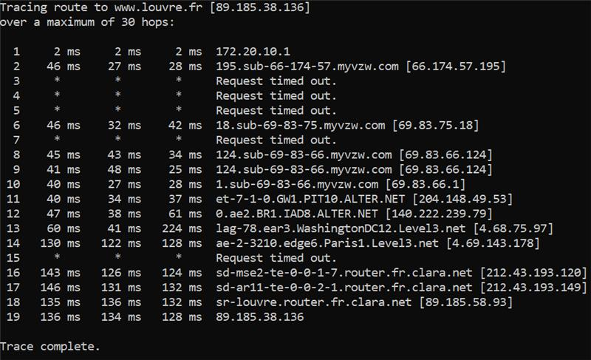
Analyze a Trace Route
Below is a trace route to www.louvre.fr (the Louvre’s website)
From Columbus, OH (Windows)
Can you identify the following route from the hostnames in the path?
Pittsburgh, PA
Dulles, VA
Washington D.C.
Paris, France
What does the “Request timed out” lines mean?

Slide 10
Analyze a Trace Route
Below is a trace route to www.louvre.fr (the Louvre’s website)
From Columbus, OH (Windows)
Pittsburgh, PA
Dulles, VA (IAD is the airport code for Dulles International Airport right outside Washington DC)
Washington, DC
Paris, France
France
A “request timed out” line means that the host refused to send back their details. How does this help secure this website?

Slide 11
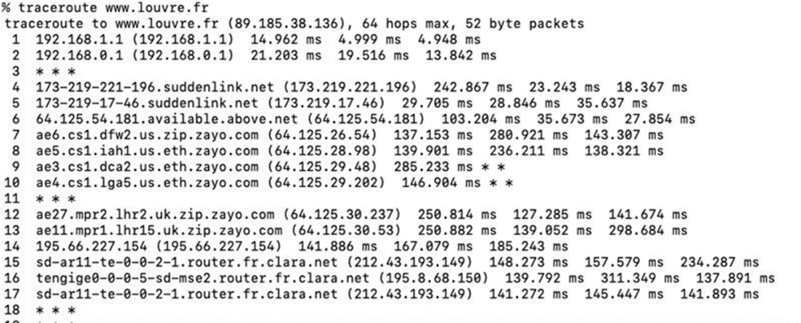
Analyze a Trace Route (Again)
Here is another traceroute to www.louvre.fr
From Bossier City, LA (Mac)
What route did this trace route take?
Can you find any cities in this path?
How did this trace route compare with the previous one?
Notice the time of the hops once it is overseas.

Slide 12
Analyze a Trace Route (Again)
Here is another traceroute to www.louvre.fr
From Bossier City, LA (Mac)
Notice the time this hop takes
Once overseas, notice it’s much longer
Can you follow this route?
Dallas, TX
Houston, TX
Washington D.C.
New York, NY
Great Britain (UK)
France

Slide 13
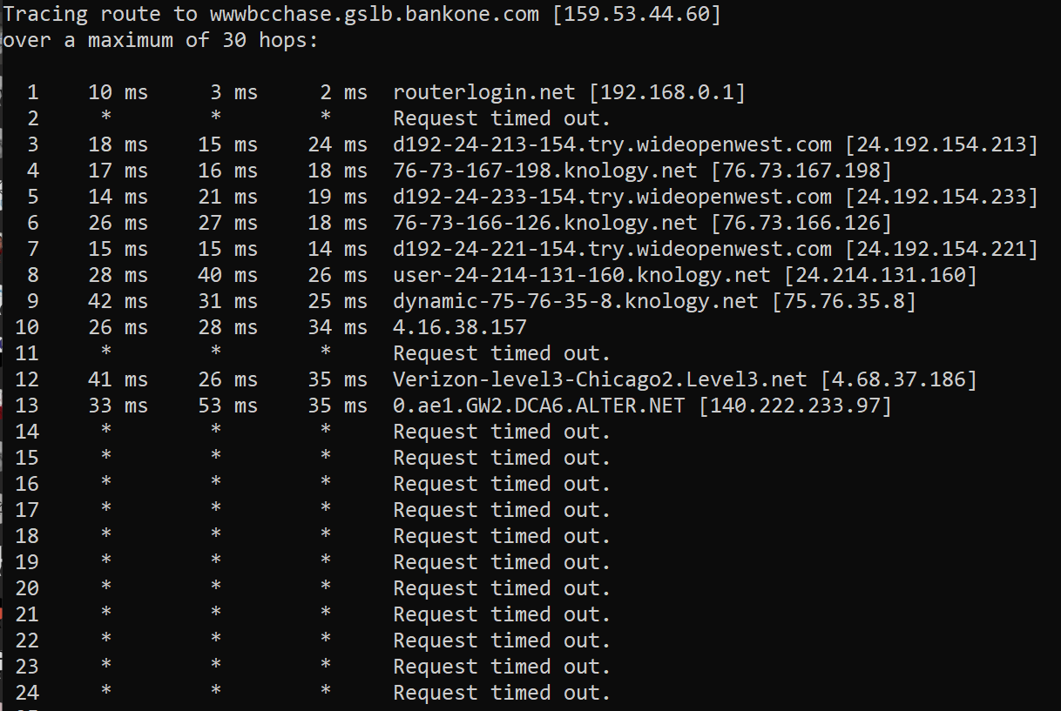
Analyzing a Secure Website
Let’s look at a traceroute to www.chase.com (Chase Bank)
Notice that Chase nodes do not respond back
Why would they do this?
Not sharing any data back

Slide 14
Your Turn
Run another traceroute to a different website
Examples:
bbc.co.uk
tpic.com.tr
dailymirror.lk
How many hops did it take?
What were you able to determine from this traceroute?
Any cool or interesting findings?

